Slide 1
GROUP 4
Demo 1 Algorithm
Ariff, Shaun, Chai, Min Wei & Bellamy

Slide 2
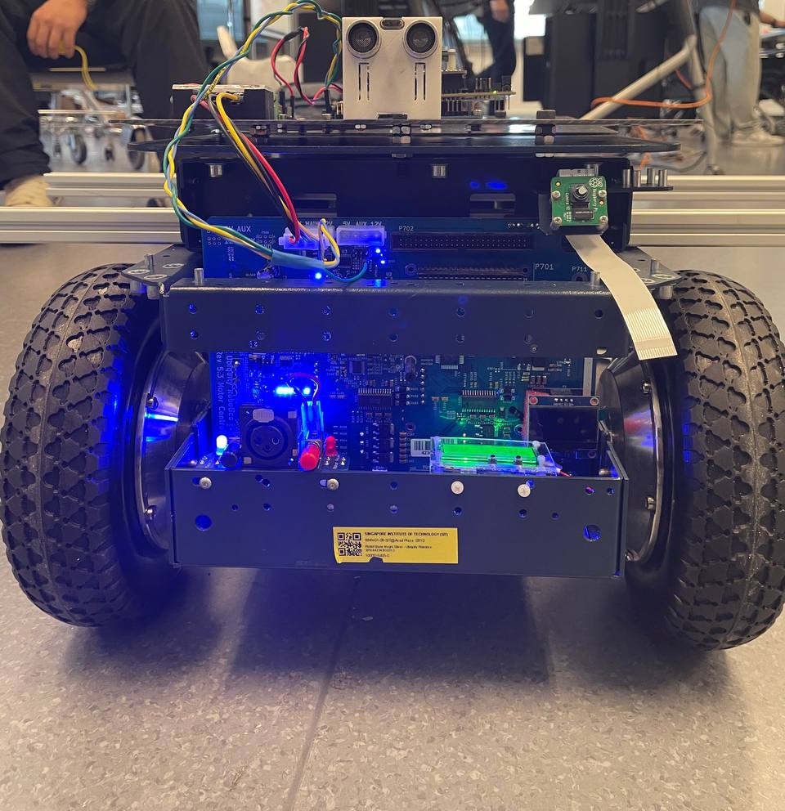
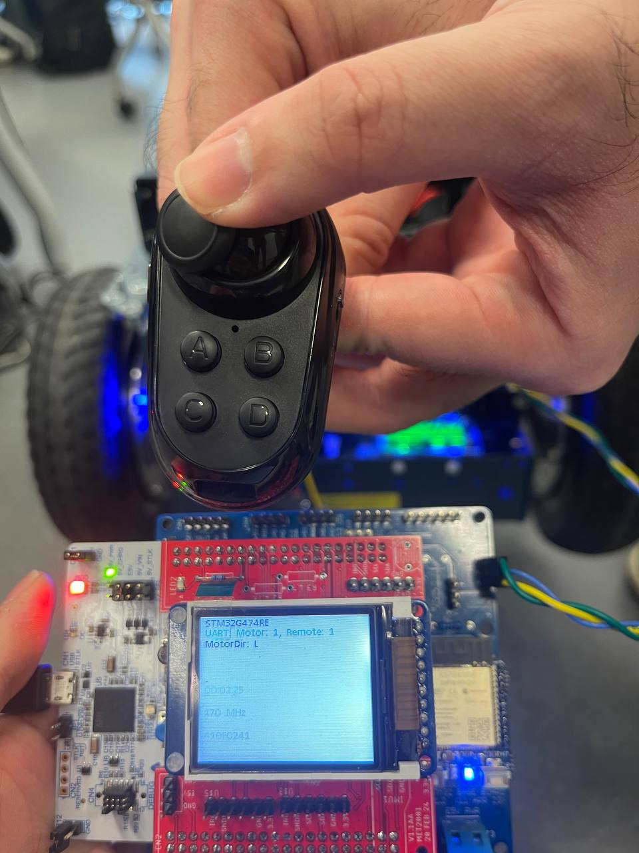
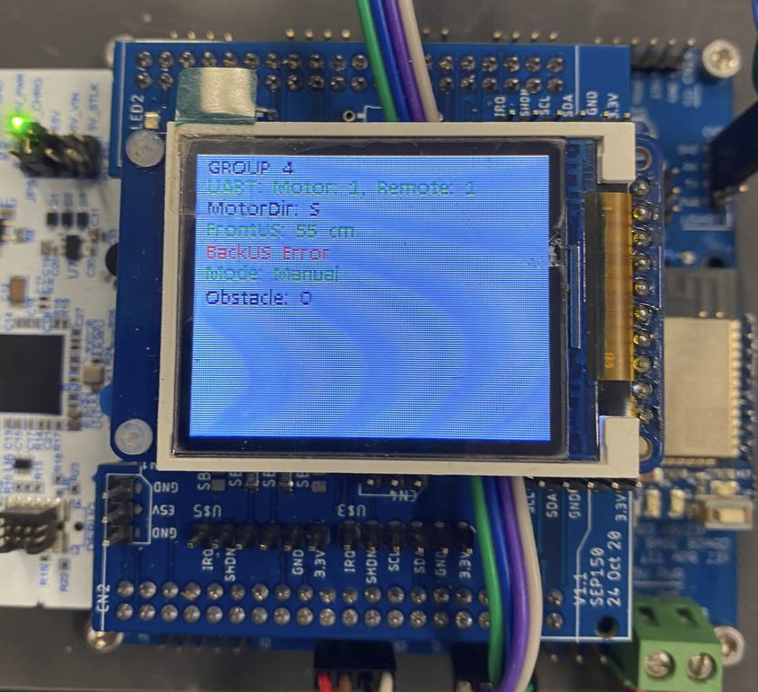
Algorithm Features
Autonomous and manual | Autonomous(Movement Determined by Sensors), Manual(Determine by remote)
LCD Interface to check various status(Real Time) | LCD displays, Mode, Motor Direction, Counter for obstacles detected and Sensor Status
Automatic Change of Mode | Mode resets automatically after autonomous code ends
Immediate takeover | Immediate takeover of AMR when user presses button
Code Efficiency | Utilises interrupts instead of polling

Slide 3
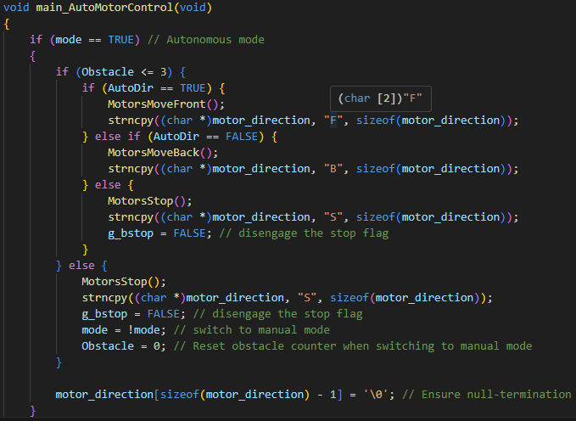
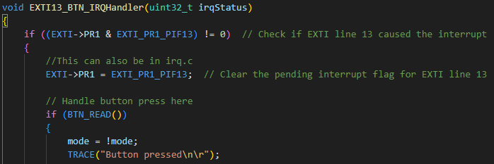
Autonomous & Manual
Utilises a global variable to be used as a flag.
Autonomous=True. Manual=False
The flag is toggled everytime the button interrupt occurs

Slide 4
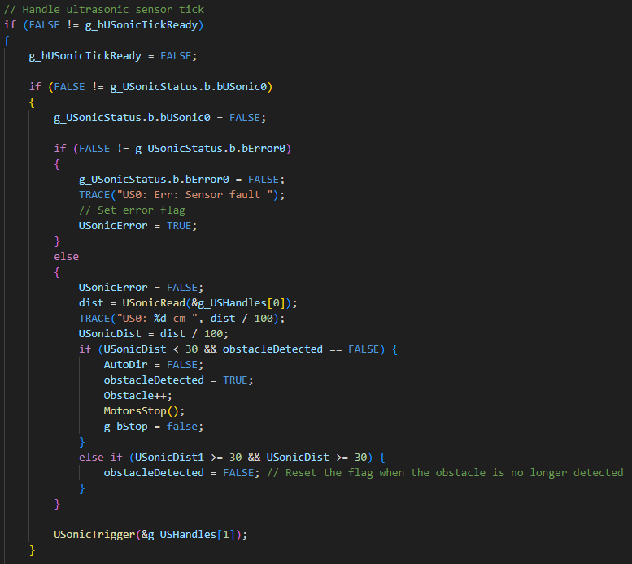
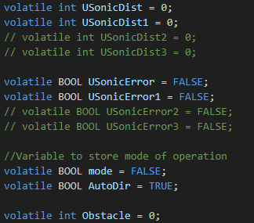
Autonomous & Manual
Autonomous mode is also controlled by flags.
A obstacles is incremented to when detected

Slide 5
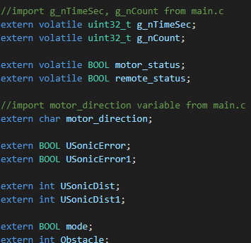
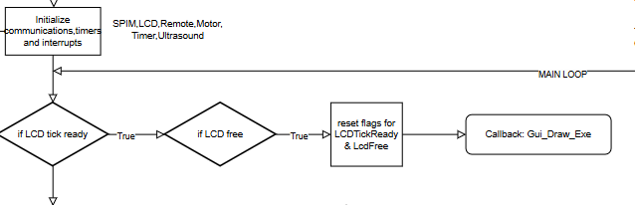
LCD Interface(Custom Library)
main.c
LcdFunctions.c
Main algorithm to navigate and control
imports variables and flags declared in main.c to print out on LCD
Why do so? Abstraction. The main navigation and control should be in the main.c

Slide 6
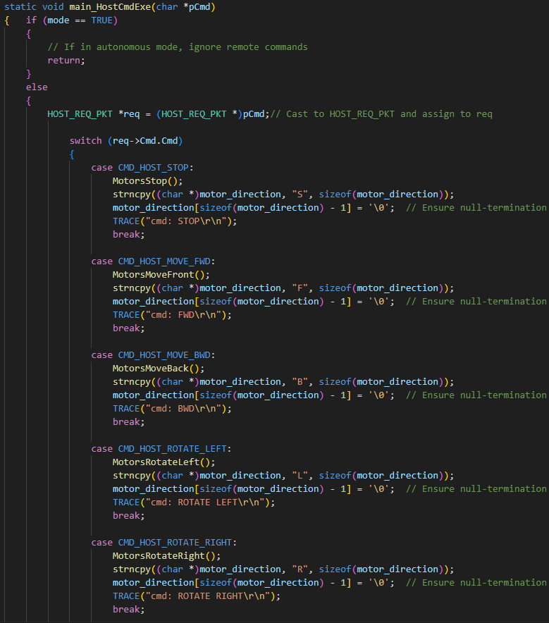
Automatic Change Of Mode
mode= !mode
mode is toggled to change back and enable remote commands to control

Slide 7
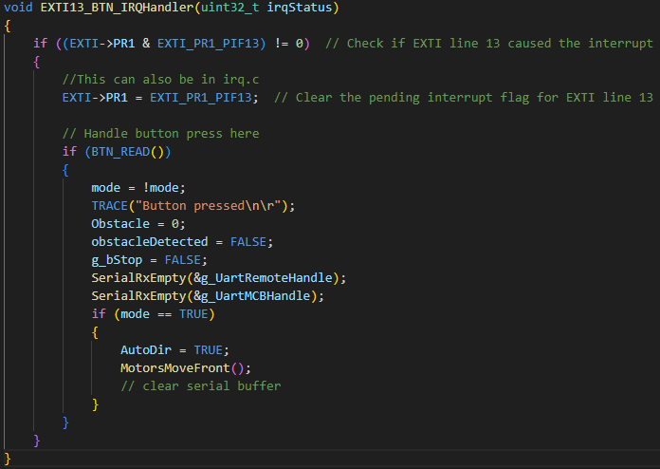
Immediate Takeover
Clearing Remote/MCB Buffers!
Buffers are cleared to remove the previous commands sent!
g_bStop=False ,disengages the brakes

Slide 8
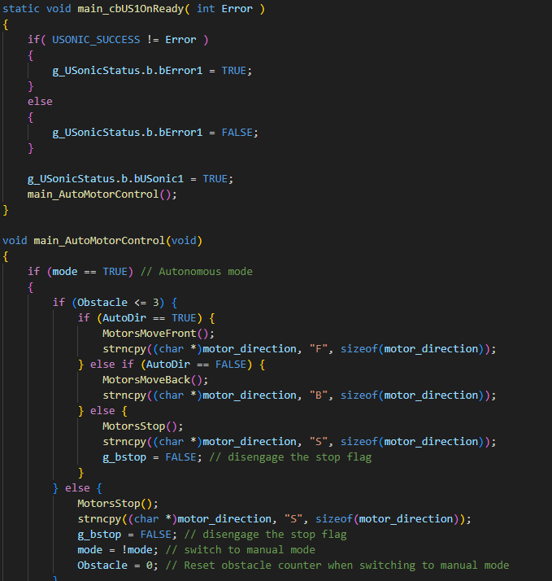
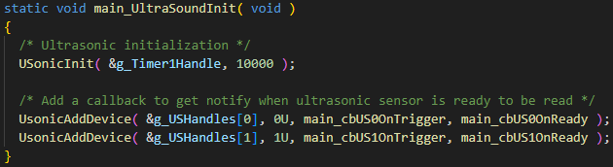
Code Efficiency
01
02
Callback Functions
Main Autonomous navigation is in a callback function
Interrupts
The main autonomy navigation only is called when the Ultrasonic interrupt occurs!
Why? Movement only needs to be done when sensor reads!

Slide 9
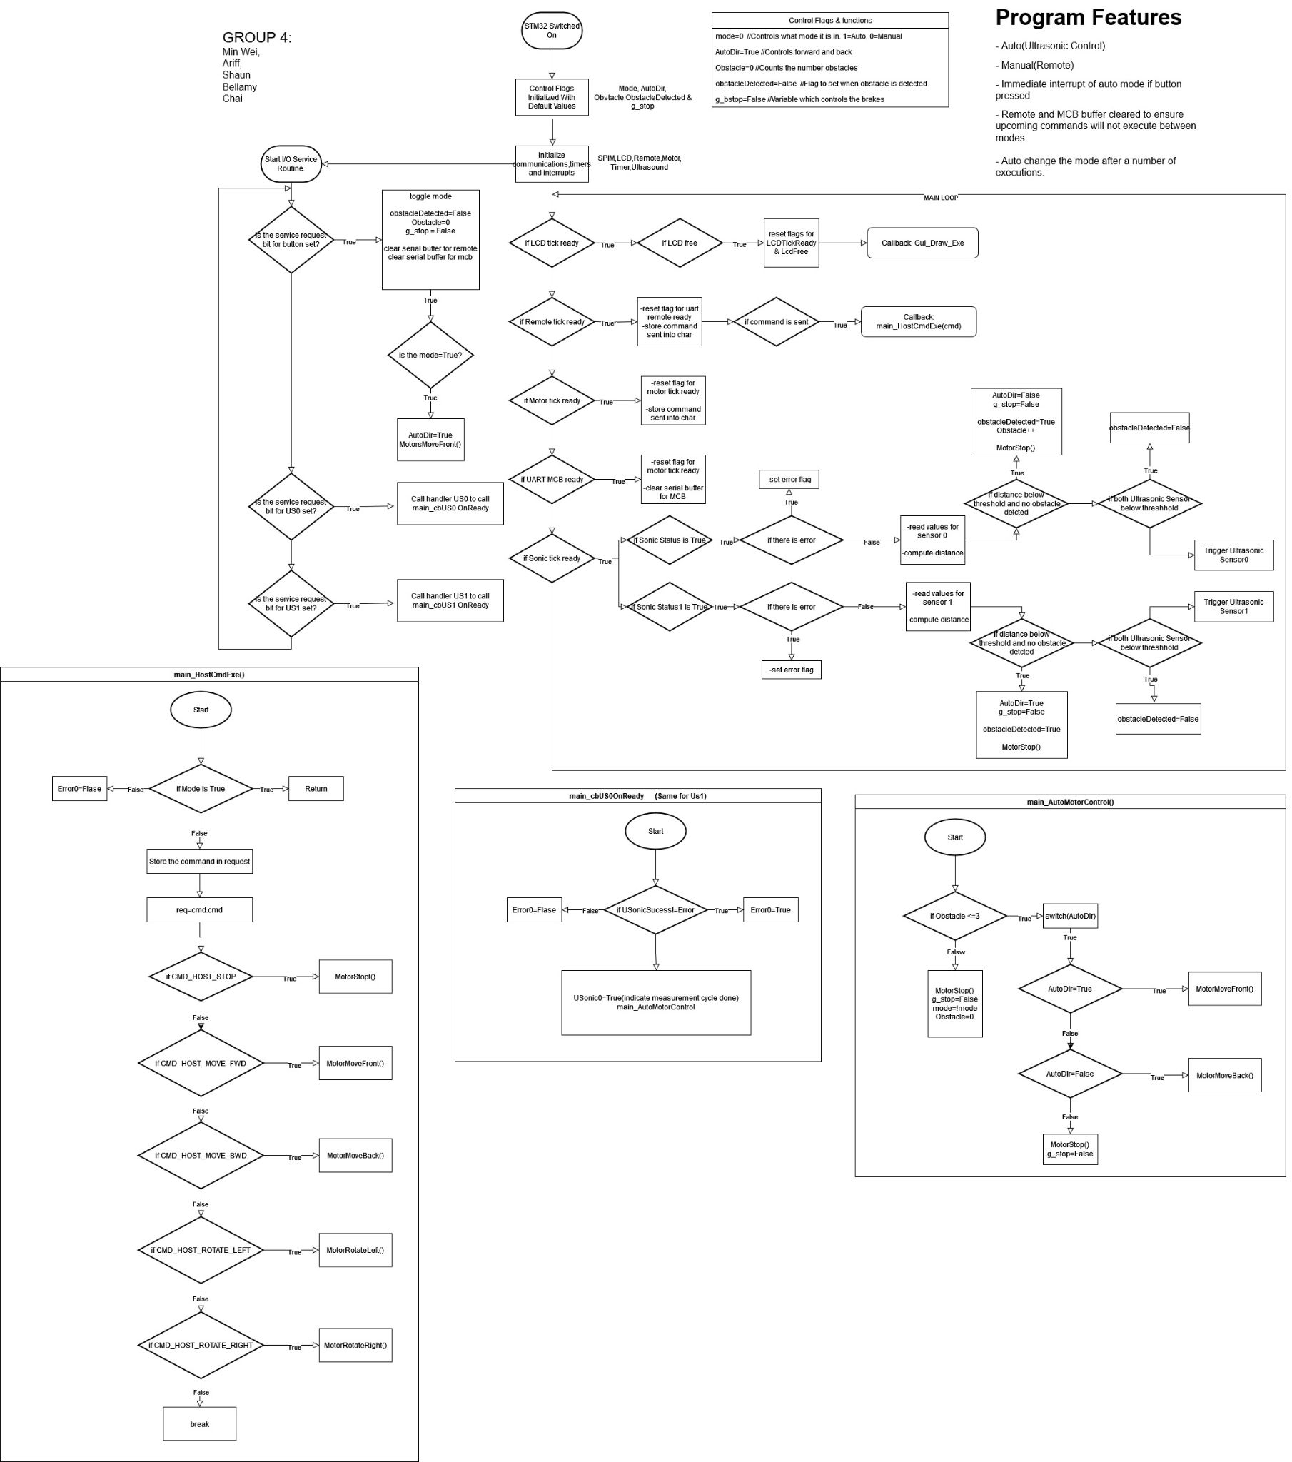
Algorithm
Flowchart
THANK YOU!

